Slide 1

Digit recognition
Project Proposal
Presented by Daria Morkis, Alex Kohlmann and Karolina Walach
Supervisor: Dr. Leonid Kostrykin, PD Dr. Karl Rohr
Tutor: Hannah Winter

Slide 2
What is “Digit recognition”?
“Digit recognition is the ability of computers to recognize human handwritten digits”
(data-flair.training)

Slide 3
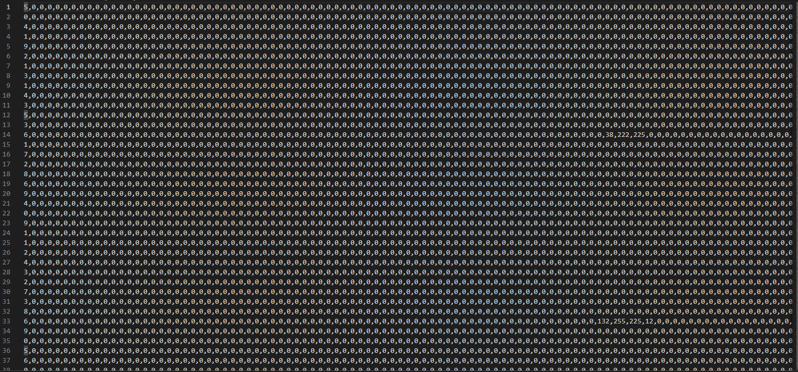
Pixel Values
Label

Slide 4

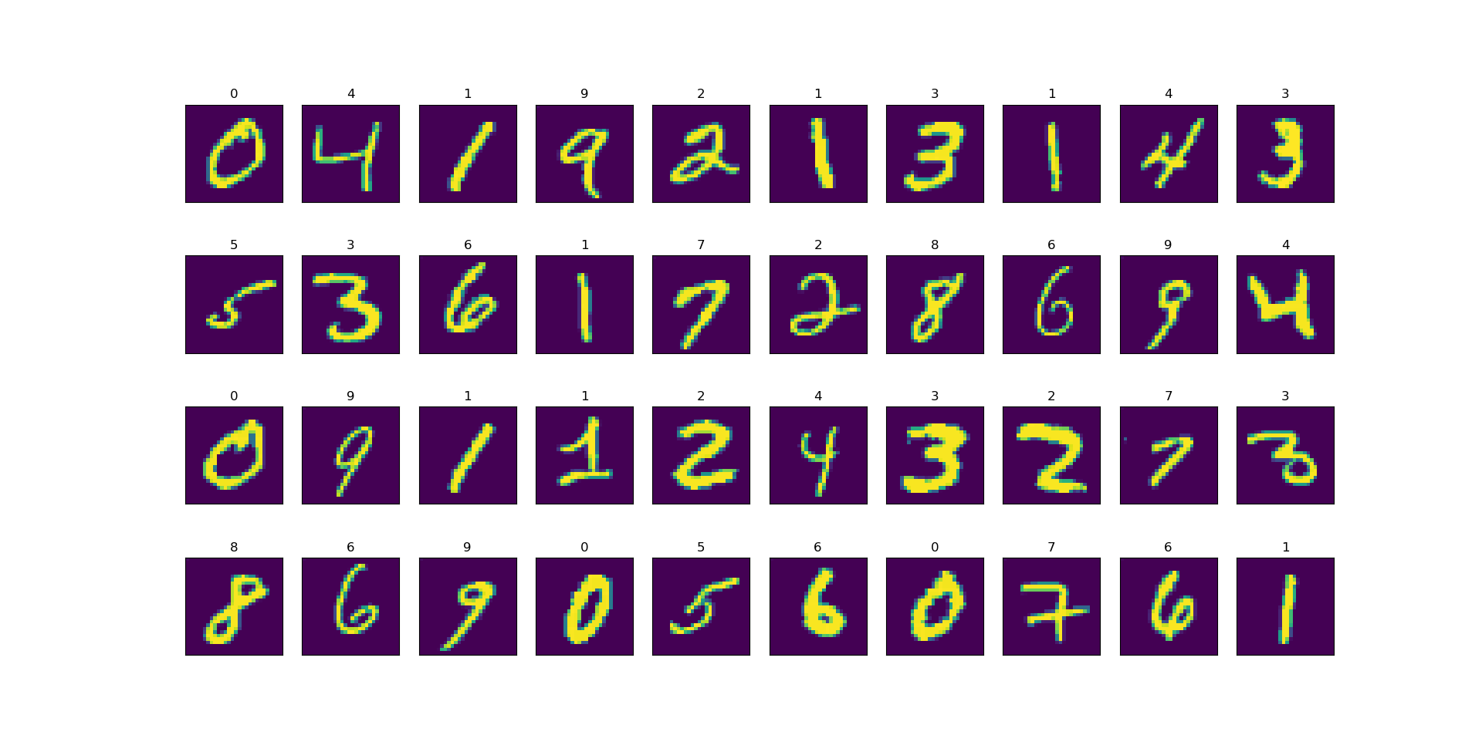
Conversion with matplotlib

Slide 5
List of planned analysis steps
Principal Component Analysis (PCA)
Z-transform, covariance, eigenvalues and -vectors
K-Nearest Neighbour (KNN)
Euclidian distance, distance sorting, most common neighbours, prediction of class
Evaluation
Accuracy, optimizing PC/K-value, error analysis
Additional:
Implementation of a neural network / comparing outcomes

Slide 6
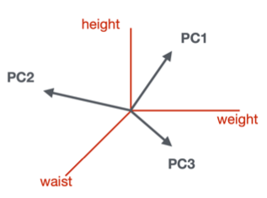
Principal Component Analysis (PCA)
60.000 dimensions n principal components (reduction of dimensions)
Value 1
Value 2
Value 3

Slide 7




Principal Component Analysis (PCA)
Import libraries and dataset
z-transform
u
$$z=\frac{x−μ}{σ}$$
Implement PCA
Covariance
Eigenvalues and -vectors $Xv=λv$
eigenvector of X
eigenvalue of X

Slide 8
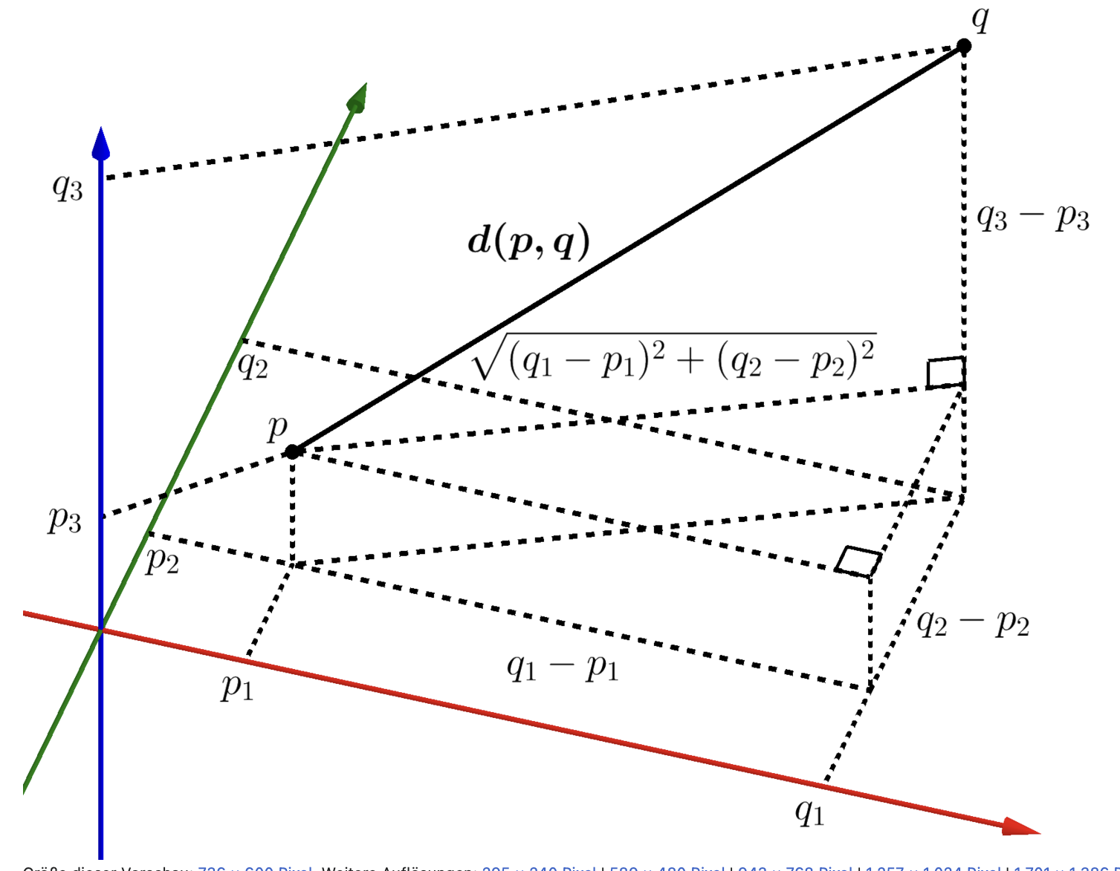
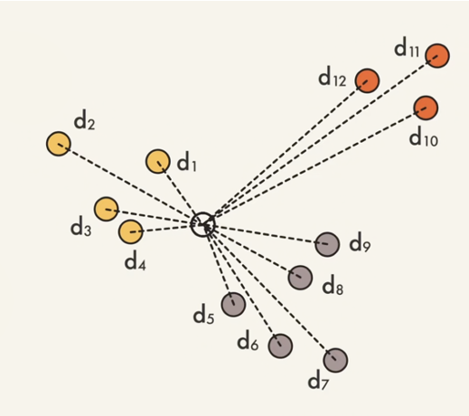

K-Nearest Neighbour (KNN) algorithm
Euclidean distance
length of line segment between two points
$d\left(p,q\right)=\sqrt{\sum_{i=1}^{n}{{(q_{i}−p_{i})}^{2}}}$
https://de.wikipedia.org/wiki/Euklidischer_Abstand
calculating distance between test data image and train data images
Euclidean distance: square of the differences between their coordinates in n-dimensional space (set by PCA)
https://youtu.be/0p0o5cmgLdE

Slide 9
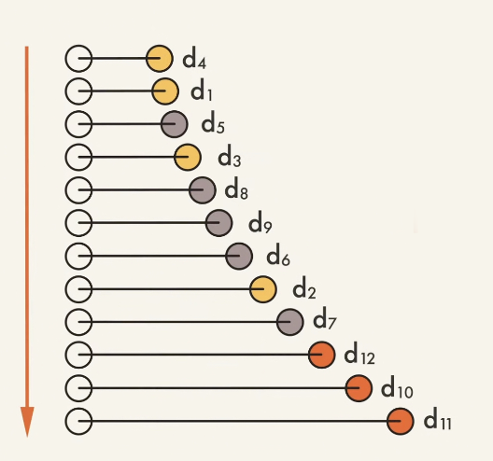
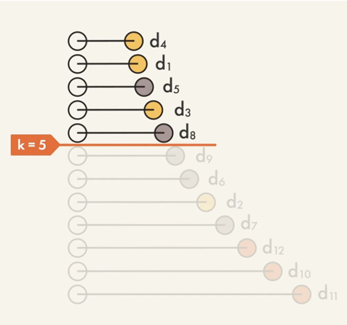
K-Nearest Neighbour (KNN) algorithm
Sort distances in ascending order
sorting labeled neighbors (train data points) by ascending distance
Get the k nearest neighbors by taking top k rows from sorted array
Most common neighbours
select the most common labels (digits) for these rows by majority vote
predicting class of new data point
Evaluation
computing mean accuracy
https://youtu.be/0p0o5cmgLdE

Slide 10
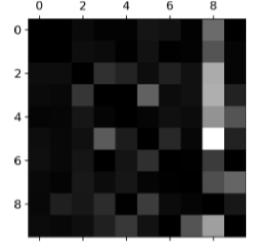
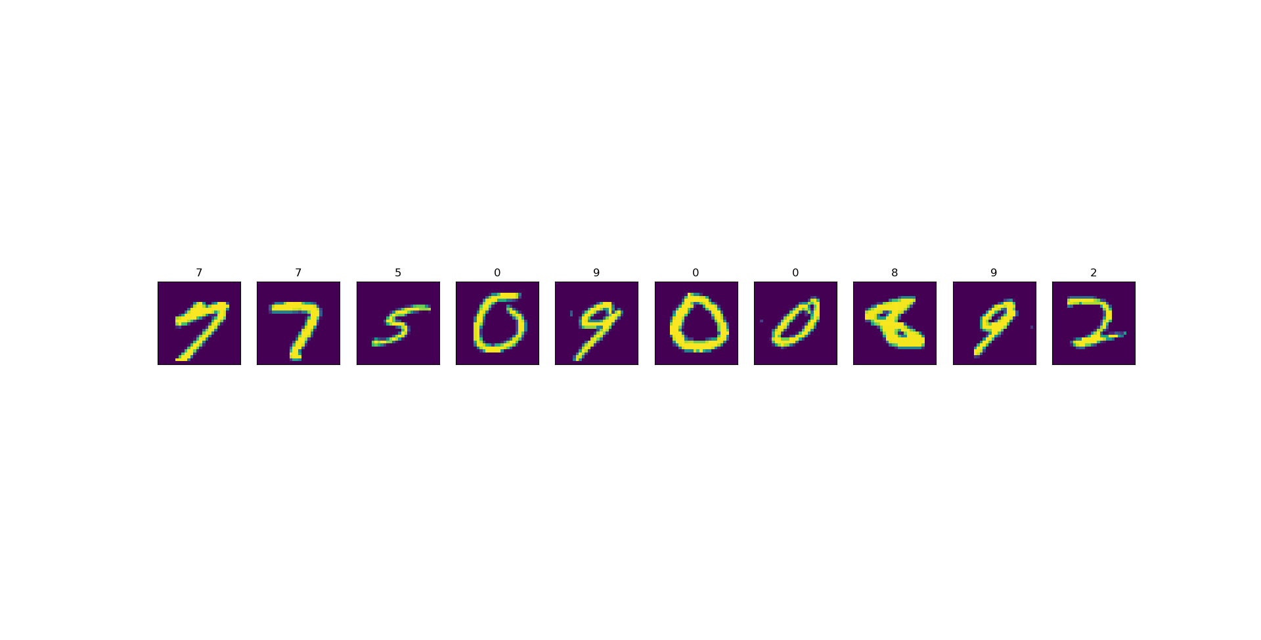
Problem Nr.1
Some numbers are difficult to distinguish
1 or 7?
Estimating error frequency with e.g. confusion matrix
Géron, A. (2017). Hands-on machine learning with Scikit-Learn and TensorFlow (Sebastopol, CA: O’Reilly Media).

Slide 11
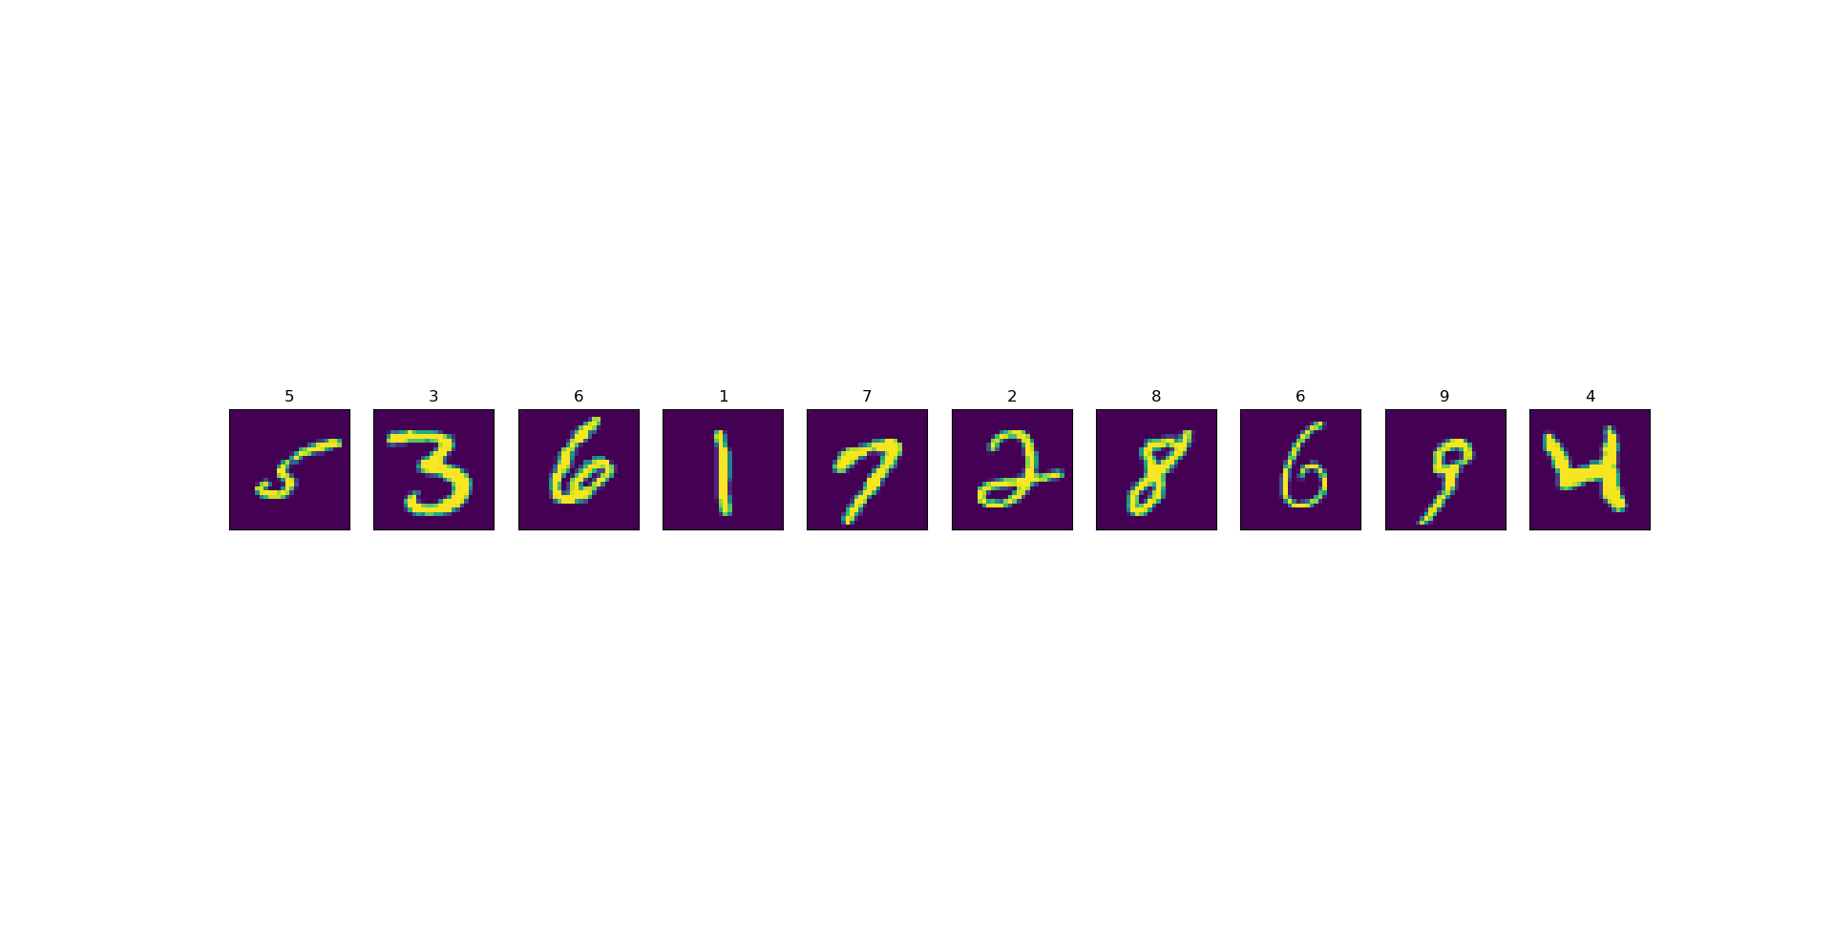
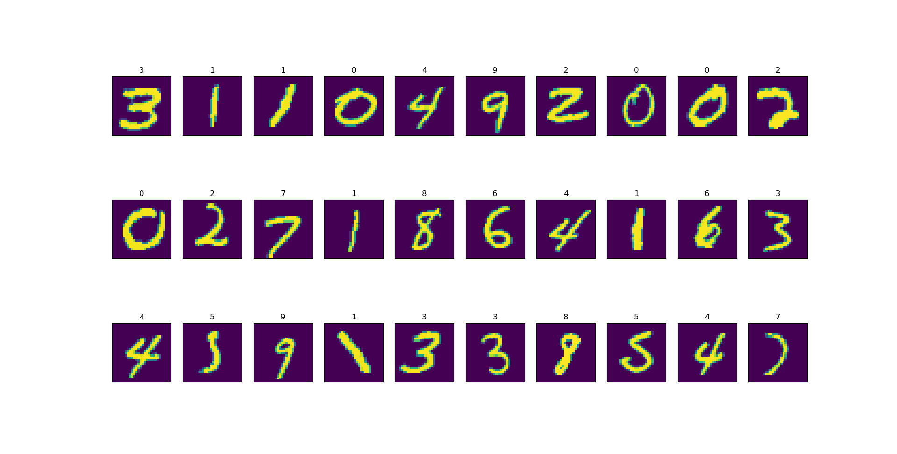
Solution for Problem Nr.1
Some numbers are difficult to distinguish
Solution: implementation of an algorithm that recognizes closed loops

Slide 12
Problem Nr. 2
2. Principal components: Tradeoff run-time vs. variance
many PCs
few PCs
high explanation of variance
low explanation of variance
high run-time
low run-time

Slide 13
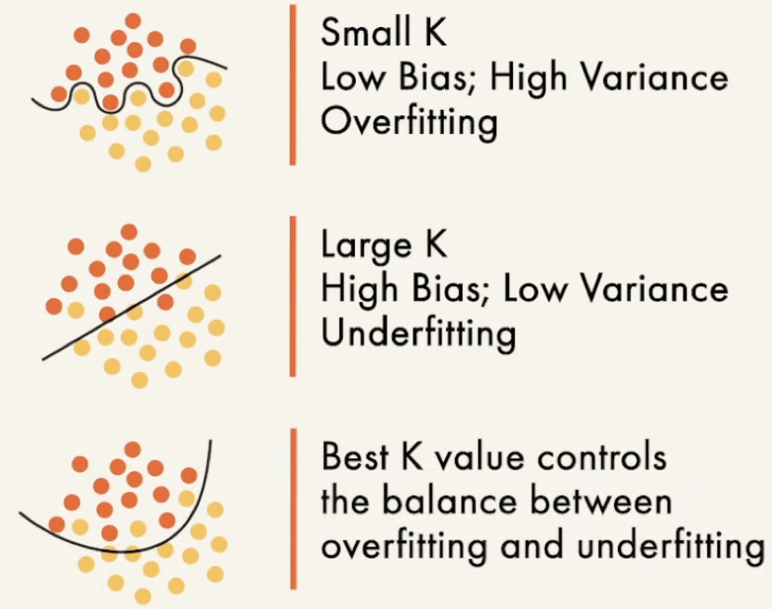
Problem Nr. 3
3. over- and underfitting of k-value
write an algorithm which determines best k-value
https://youtu.be/0p0o5cmgLdE

Slide 14
Approximate timetable
May
June
July
17
24
31
7
14
21
28
5
12
19
Project proposal
Final presentation
Milestone 1
Milestone 2
Milestone 3
Task 1
Task 4
Task 6
Task 8
Task 9
Daria
Import libraries and data
K-nearest neighbor after sorting distance
Comparison of
our KNN vs. scikit KNN
Implement algorithm to determine best k-value
Presentation preparation
Task 2
Task 5
Task 7
Task 9
Karolina
Z-transform and PCA
Most common neighbours & evaluation
Error analysis
and
Improvements
Presentation preparation
Sub-swimlane 1
Task 3
Task 7
Task 9
Alex
Swimlane 3
Euclidian distance
Error analysis
and
Improvements
Presentation preparation
Sub-swimlane 2
Convolutional Neural Network

Slide 15
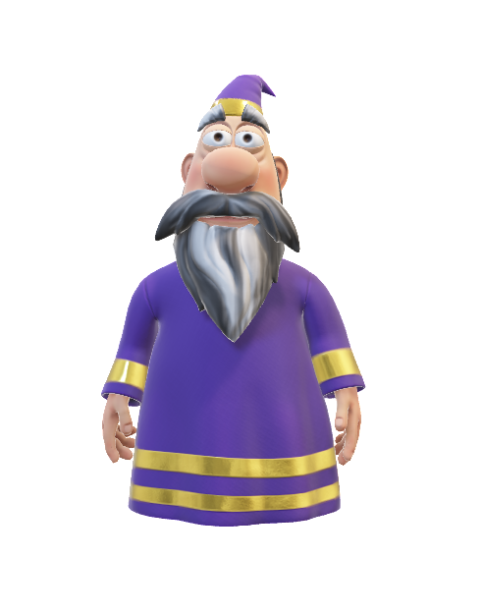
Thank you for listening
Questions?

